Slide 1
FINAL PROJECT (DATA 1204)
Oluwaseyi Babalola - 100808940

Slide 2
Content Of The Report
Description Of The Research
Summary Of Basic Statistics From The Data
T-Test Analysis
Simple Linear Regression Analysis
Multiple Linear Regression Analysis
Conclusions

Slide 3
Hypothesis Statement

Slide 4
Description Of The Research
Mr. John Hughes has asked us to conduct analysis on a dataset. The dataset contains data pertaining to certain personal attributes (i.e., Age, Sex, Body Mass Index, Number of Children, If they smoke & Location) that could possibly influence household expenses.
This research would:
Try to determine if the average household expense is equal to $10,000
Determine the relationship between Expenses and the personal attributes using two regression models, namely:
Simple Linear Regression Model
Multiple Linear Regression Model

Slide 5
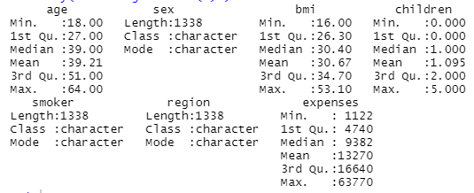
Summary Of Basic Statistics From The Data
AGE: The respondents under review ranged from age 18 to 64 with an average age of 39.21. 25% of the respondents were aged between 18 & 27, while 75% of the respondents were aged 51 to 64.
BMI: The BMIs recorded averaged out to around 30.67, ranging from 16 to 53.1. 25% of BMIs recorded were between 16 and 26.3, while 75% were between 34.7 & 53.1.

Slide 6
Summary Of Basic Statistics From The Data
CHILDREN: The respondents had 1.095 children on average. Some had no children while the max children in a single household was 5. 25% of the households had no children, while 75% of the households had 2 to 5 children.
EXPENSES: Households maintained average expenses of around $13,270, ranging from $1,122 to $63,770. 25% of households spent $4,740, while 75% of the households spent $16,640.

Slide 7
Summary Of Basic Statistics From The Data
Data for the following attributes were categorical:
Sex – Male or Female
Smoker – To determine if a respondent smokes or not
Region – Tells of where a household lives

Slide 8
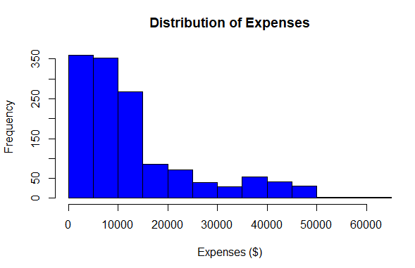
Summary Of Basic Statistics From The Data
SKEWNESS – The expenses of the households are right skewed
SYMMETRY – The Expenses are not symmetrical
NORMARLITY – The Expenses of the households are not normally distributed with most households spending below $15,000.

Slide 9
Summary Of The Analysis

Slide 10
T-Test
NULL HYPOTHESIS
H₀: The mean of expenses accrued by the households is equal to 10,000
H₀: μ_{h} = $10,000
ALTERNATIVE HYPOTHESIS
H_{a} : The mean of expenses accrued by the households is NOT equal to 10,000
H_{a}: μ_{h} ≠ $10,000
SIGNIFICANCE LEVEL
The significance level utilized for this analysis is 0.05
α = 0.05

Slide 11
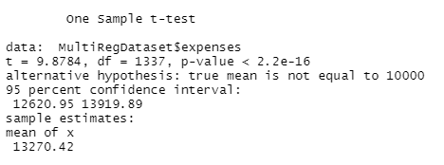
T-Test Results
Since the P-Value is 2.2e-¹⁶ which is much lower than significance level of 0.05 we can reject the null hypothesis.
This means that we have enough evidence to reject the null hypothesis that states that the mean of household expenses is $10,000.

Slide 12
T-Test
NULL HYPOTHESIS
Ho: β=0, co-efficient of the predictor i.e., slope is zero and not statistically significant
ALTERNATIVE HYPOTHESIS
Ha: β ≠0, co-efficient of the predictor i.e., slope is not equal to zero and is statistically significant

Slide 13
Simple Linear Regression Model

Slide 14
The Simple Linear Model Results
NULL HYPOTHESIS
H₀: There is a relationship between smoking and expenses
ALTERNATIVE HYPOTHESIS
H_{a} : There is NO relationship between smoking and expenses

Slide 15
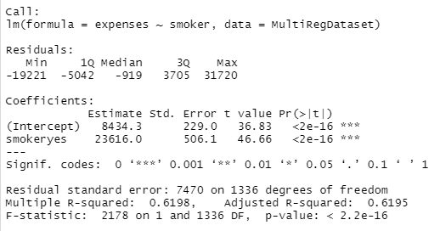
The Simple Linear Model Results

Slide 16
The Equation
Y = β1 + β2X + ϵ
Where:
Y = the variable we’re trying to predict = Expenses
β1 = coefficient of the intercept = 8434.3
β2 = coefficient of the slope = 23616.0
X = the predictor variable = Smoker
ϵ = error term.
Y(Expenses) = 8434.3 + 23616.0 X(Smoker)

Slide 17

Insights
The Residuals explain the difference between the values observed and the predicted values of what was observed. By this definition, we can call them errors. They represent how far away data points are from the line of best fit.
The values above show a wide range of residual values which suggest a weak relationship between Smokers and Expenses

Slide 18

Insights
The Estimates indicate that for every 1% increase in Yes Smokers, there would be a 23616% increase in “Expenses”.
The level of variance between the estimates of the model and what is observed from the data is 229.0 (Expenses) and 506.1 (Smokers).
The t-value represents the quotient of Std error and Estimate and is a test value of how much the coefficients are close to 0. t-value of 46.66 suggests that “smokers” is not of any significant value to the model and should be discarded. This is because of the categorical nature of the variable

Slide 19

Insights (Performance Measures)
The Residual standard error tells us that the model is predicting “Expenses” with an average error of 7470, which is too high
R-squared is the square of the correlation coefficient of the variables. 0.6198 suggests there is some correlation between them but ther factors need to be considered.
The P-value is the most important performance measure of the model. A p-value of 2.2e-16 at 0.05 significance level shows that the model is performing reasonably well for this analysis.

Slide 20
Summary
Purpose:
The purpose of this model is to determine the linear relationship between Smokers (independent variable) and Expenses (dependent variable) in analyzing the effect of smoking on Expenses.
The model would tell us if the relationship is significant or not. The results suggests there is some relationship.
Conclusion:
Since the P-Value 2.2e-16 is less than the significance level 0.05, we do not have enough evidence to reject the null hypothesis that states that there is a relationship between the 2 variables.
This means there is evidence of a relationship between them

Slide 21
Multiple Linear Regression Model

Slide 22
The Multiple Linear Model Results
NULL HYPOTHESIS
H₀: There is a relationship between the household attributes I.e., Sex, Age, BMI, Smokers, Children, Region; and Expenses
ALTERNATIVE HYPOTHESIS
H_{a} : There is NO relationship between the household attributes I.e., Sex, Age, BMI, Smokers, Children, Region; and Expenses

Slide 23
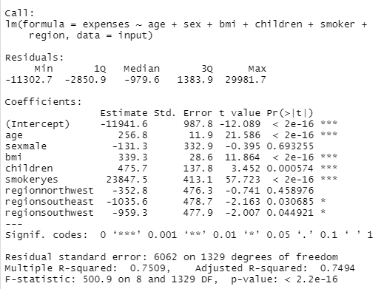
The Model Results

Slide 24
The Equation
Y = β₀ + β₁ X₁ + β₂ X₂ + β₃ X₃ + β₄ X₄ + β₅ X₅ + β₆ X₆
Where:
Y = the variable we’re trying to predict = Expenses
X₁ = Age; X₂ = Sex; X₃ = BMI; X₄ = Children; X₅ = Smoker; X₁ = Region;
β₀ = coeff. of the intercept = -11941.6; β₁ = coeff. of age = 256.8; β₃ = coeff. of BMI = 339.3;
β₄ = coeff. of children = 475.7;
β₂ = coeff. of sex = {-131.3 when X₂ = male; 0 when X₂ = female}
β₅ = coeff. of smoker = {23847.5 when X₅ = Yes; 0 when X₅ = No}
β₅ = coeff. of region = {-352.8 when X₅ = NW ; -1035.6 when X₅ = SE ; -959.3 when X₅ = SW}
Y(Expenses)
= -11941.6 + (256.8 * X₁) + (β₂ X₂) + (339.3 * X₃) + (475.7 * X₄) + (β₅ X₅) + (β₆ X₆)

Slide 25

Insights
The Residuals explain the difference between the values observed and the predicted values of what was observed. By this definition, we can call them errors. They represent how far away data points are from the line of best fit.
The values above show a wide range of residual values skewed towards the maximum value (right skewed).

Slide 26
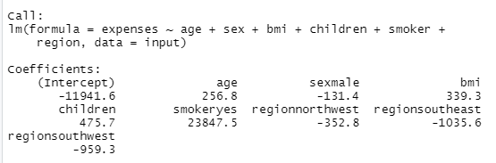
Insights
The Estimates indicate that for every 1% increase in age, there would be a 256.8% increase in Expenses.
The Estimates indicate that for every 1% increase in male respondents, there would be a 131.4% decrease in Expenses.
The Estimates indicate that for every 1% increase in BMI, there would be a 339.9% increase in Expenses.
The Estimates indicate that for every 1% increase in children, there would be a 475.7% increase in Expenses.

Slide 27
Insights
The Estimates indicate that for every 1% increase in People that smoke, there would be a 23847.5% increase in Expenses.
The Estimates indicate that for every 1% increase in respondents in the North-West, there would be a 352.8% decrease in Expenses.
The Estimates indicate that for every 1% increase in respondents in the South-East, there would be a 1035.6% decrease in Expenses.
The Estimates indicate that for every 1% increase in respondents in the South-West, there would be a 959.3% decrease in Expenses.

Slide 28

Insights (Performance Measures)
The Residual standard error tells us that the model is predicting Expenses with an average error of 6062, which is high
R-squared is the square of the correlation coefficient of the dependent and independent variables. 0.7509 is high and suggests fairly strong correlation between them.
The P-value is the most important performance measure of the model. A p-value of 2.2e-16 at 0.05 significance level is a very good indication for the model.

Slide 29
Summary
Purpose:
The purpose of this model is to determine the linear relationship between Dividend (independent variable) and Stock_Return_Scaled (dependent variable) in analyzing the stock market. In so doing, we are attempting to predict dependent variable using the independent variable.
The model would tell us if the relationship is significant or not.

Slide 30
Summary
Purpose:
The purpose of this model is to determine the linear relationship between The household attributes I.e., Sex, Age, Smoker, BMI, Region, Children (independent Variable) and Expenses (dependent variable) in analyzing the effect of those attributes on Expenses.
The model would tell us if the relationship is significant or not. The results suggests there is some relationship.
Conclusion:
Since the P-Value 2.2e-16 is less than the significance level 0.05, we do not have enough evidence to reject the null hypothesis that states that there is a relationship between the 2 variables.
This means there is evidence of a relationship between them

Slide 31
Conclusion

Slide 32
Conclusion
Having considered all evidence as shown in the performance measures, and most importantly, Since The P-value is 0.7579 and significantly greater than the ideal significance level 0.05, we fail to reject the null hypothesis that:
“The co-efficient of the predictor i.e., slope is zero and not statistically significant”
This means that the model shows that there is practically no relationship between dividend and stock_return_scaled.

Slide 33
Recommendation of Variables
One measure I would recommend to be included is Stock size. There is a direct relationship between the size of stocks and the stock returns. Historically, small-cap stocks have often outperformed large-cap stocks. If the size of the stock is measured, we would be able to find a direct relationship using the linear regression model.
Another measure I would recommend is Market Risk. This is a measure of the riskiness of a stock compared with that of its benchmark. Stocks with less market risk have tended to outperform those with larger market risk over time.

Slide 34
Appendix (R-Script)
#Load_Dataset
library(readxl)
ols_stock <- read_excel("C:/Users/bablo/Desktop/Classes/1204/ols_stock.xlsx")
View(ols_stock)
#Build Linear Model
simple.fit<-lm(stock_return_scaled~dividend, data=ols_stock)
LinearModel<-simple.fit
#Summary of Key Statistics of the Model
summary(LinearModel)

